Slide 1
Key-Value Database
Module 3 - Chapter 8

Slide 2
8.1. What Is a Key-Value Store
A key-value database (sometimes called a key-value store) uses a simple key-value method to store data. [1]
These databases contain a simple string (the key) that is always unique and an arbitrary large data field (the value).
They are easy to design and implement.
This implements a hash table to store unique keys along with the pointers to the corresponding data values.
The values can be of scalar data types such as integers or complex structures such as JSON, lists, BLOB, and so on.
A value can be stored as an integer, a string, JSON, or an array—with a key used to reference that value.
It typically offers excellent performance and can be optimized to fit an organization’s needs.
Key-value stores have no query language but they do provide a way to add and remove key-value pairs.
Values cannot be queried or searched upon. Only the key can be queried.

Slide 3
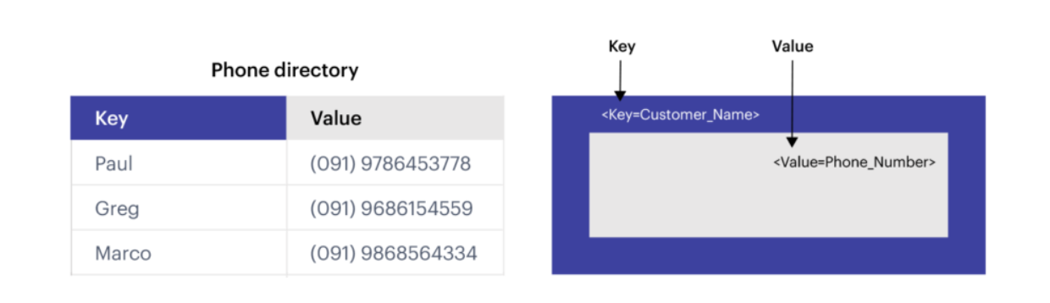
A simple example of key-value data store

Slide 4
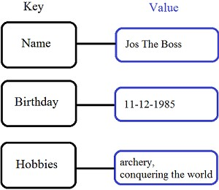
Key/Value stores
Store data in a schema-less way
Store data as maps
HashMaps or associative arrays
Provide a very efficient average running time algorithm for accessing data
Notable for:
Couchbase (Zynga, Vimeo, NAVTEQ, ...)
Redis (Craiglist, Instagram, StackOverflow, flickr, ...)
Amazon Dynamo (Amazon, Elsevier, IMDb, ...)
Apache Cassandra (Facebook, Digg, Reddit, Twitter,...)
Voldemort (LinkedIn, eBay, …)
Riak (Github, Comcast, Mochi, ...)

Slide 5
Redis
Redis is an open-source, in-memory key-value data store.
Any given Redis instance includes a number of databases, each of which can hold many different keys of a variety of data types.
In key-value stores, such as Redis, the aggregate being stored does not have to be a domain object—it could be any data structure.
Redis supports storing lists, sets, hashes and can do range, diff, union, and intersection operations.
These features allow Redis to be used in more different ways than a standard key-value store.

Slide 6
Redis Enterprise
Redis Enterprise is a robust in-memory database platform built by the people who develop open source Redis.
It maintains the simplicity and high performance of Redis, while adding many enterprise-grade capabilities, such as
linear scaling to hundreds of millions of operations per second,
Active-Active geo-replication with local latency,
Redis on Flash to tier data across dynamic and persistent memory and solid-state disk (SSD) to reduce total cost of ownership, and
five-nines (99.999%) uptime based on built-in durability and single-digit-seconds failover.
Redis Enterprise supports many data modeling methods with modules such as RediSearch, RedisJSON, RedisGraph, RedisTimeSeries, RedisBloom, and RedisAI, and allows operations to be executed across and between modules and
Core Redis functionality using RedisGears, a serverless engine that runs across shards and nodes of Redis Enterprise cluster.
All this while keeping database latency under one millisecond, so your application can respond instantaneously.

Slide 7
Riak
Riak is a distributed NoSQL key-value data store that offers high availability, fault tolerance, operational simplicity, and scalability.
Riak moved to an entirely open-source project in August 2017, with many of the licensed Enterprise Edition features being incorporated after its acquisition by Bet365.
Riak implements the principles from Amazon's Dynamo paper with heavy influence from the CAP Theorem.
It is developed by Basho Technologies.
Riak is highly distributed database software that provides scalable, reliable performance in variety of different operation environments.
Riak comes in a free open-source as wells as a paid commercial version. It is available for enterprise, cloud, Web and mobile platforms.

Slide 8
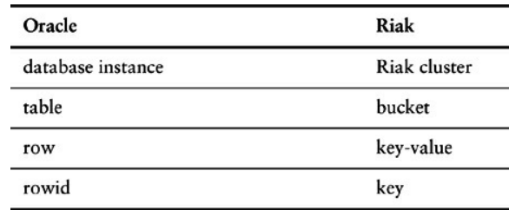
Terminology compared in Oracle and Riak.

Slide 9
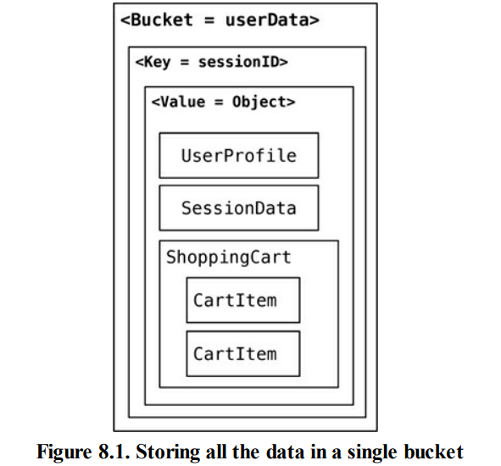
Riak lets us store keys into buckets.
If we wanted to store user session data, shopping cart information, and user preferences in Riak, we could just store all of them in the same bucket with a single key and single value for all of these objects.
In this scenario, we would have a single object that stores all the data and is put into a single bucket as shown in Figure 8.1

Slide 10
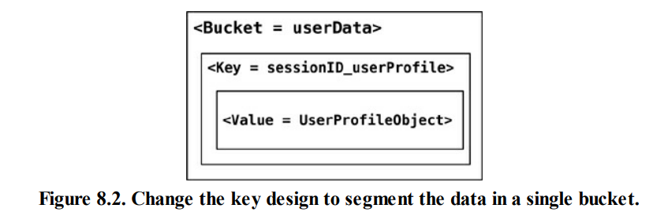
Alternate approach
Create buckets which store specific data:-
Bucket bucket = client.fetchBucket(bucketName).execute();
DomainBucket<UserProfile> profileBucket =
DomainBucket.builder(bucket, UserProfile.class).build();

Slide 11
Using domain buckets or different buckets for different objects (such as UserProfile and ShoppingCart) segments the data across different buckets allowing to read only the object which is needed without having to change key design.
Key-value stores such as Redis also support storing random data structures, which can be sets, hashes, strings, and so on.
This feature can be used to store lists of things, like states or addressTypes, or an array of user’s visits.

Slide 12
When to use a key-value database
When your application needs to handle lots of small continuous reads and writes, that may be volatile. Key-value databases offer fast in-memory access.
When storing basic information, such as customer details; storing webpages with the URL as the key and the webpage as the value; storing shopping-cart contents, product categories, e-commerce product details
For applications that don’t require frequent updates or need to support complex queries.

Slide 13
Key-Value store features
Consistency
Transactions
Query Features
Structure of Data
Scaling

Slide 14
8.2.1. Consistency
Consistency is applicable only for operations on a single key
In distributed key-value store implementations (Riak), the eventually consistent model of consistency is implemented.
Since the value may have already been replicated to other nodes, there has two ways of resolving update conflicts:
either the newest write wins and older writes loose, or
both (all) values are returned allowing the client to resolve the conflict.

Slide 15
In Riak, these options can be set up during the bucket creation.
Buckets are just a way to namespace keys so that key collisions can be reduced—for example, all customer keys may reside in the customer bucket.
When creating a bucket, default values for consistency can be provided, for example that a write is considered good only when the data is consistent across all the nodes where the data is stored.
Bucket bucket = connection .createBucket(bucketName) .withRetrier(attempts(3)) .allowSiblings(siblingsAllowed) .nVal(numberOfReplicasOfTheData) .w(numberOfNodesToRespondToWrite) .r(numberOfNodesToRespondToRead) .execute();

Slide 16
8.2.3 Transaction
A business transaction may be something like browsing a product catalog, choosing a bottle of Bisleri at a good price, filling in credit card information, and confirming the order.
Riak uses the concept of quorum implemented by using the W value —replication factor—during the write API call.
Example: Assume we have a Riak cluster with a replication factor of 5 and we supply the W value of 3. When writing, the write is reported as successful only when it is written and reported as a success on at least three of the nodes. This allows Riak to have write tolerance;
In our example, with N equal to 5 and with a W value of 3, the cluster can tolerate N - W = 2 nodes being down for write operations, though we would still have lost some data on those nodes for read

Slide 17
3. Query Feature
All key-value stores can query by the key
Riak Search that allows you to query the data just like you would query it using Lucene indexes.
Bucket bucket = getBucket(bucketName); IRiakObject riakObject = bucket.store(key, value).execute();

Slide 18
When writing to the Riak bucket using the store API, the object is stored for the key provided. Similarly, we can get the value stored for the key using the fetch API
Bucket bucket = getBucket(bucketName);
IRiakObject riakObject = bucket.fetch(key).execute();
byte[] bytes = riakObject.getValue();
String value = new String(bytes);

Slide 19
Riak provides an HTTP-based interface, so that all operations can be performed from the web browser or on the command line using curl. Let’s save this data to Riak:
{ "lastVisit":1324669989288, "user":{ "customerId":"91cfdf5bcb7c", "name":"buyer", "countryCode":"US", "tzOffset":0 } }

Slide 20
Use the curl command to POST the data, storing the data in the session bucket with the key of a7e618d9db25 (we have to provide this key):
curl -v -X POST -d ' { "lastVisit":1324669989288, "user":{"customerId":"91cfdf5bcb7c", "name":"buyer", "countryCode":"US", "tzOffset":0} }' -H "Content-Type: application/json" http://localhost:8098/buckets/session/keys/a7e618d9db25
The data for the key a7e618d9db25 can be fetched by using the curl command:
curl -i http://localhost:8098/buckets/session/keys/a7e618d9db25

Slide 21
Use cases for key-value databases
Session management on a large scale.
Using cache to accelerate application responses.
Storing personal data on specific users.
Product recommendations, storing personalized lists of items for individual customers.
Managing each player’s session in massive multiplayer online games.

Slide 22
Use cases
Session store
A session-oriented application such as a web application starts a session when a user logs in and is active until the user logs out or the session times out. During this period, the application stores all session-related data either in the main memory or in a database. Session data may include user profile information, messages, personalized data and themes, recommendations, targeted promotions, and discounts. Each user session has a unique identifier. Session data is never queried by anything other than a primary key, so a fast key-value store is a better fit for session data. In general, key-value databases may provide smaller per-page overhead than relational databases.
Shopping cart
During the holiday shopping season, an e-commerce website may receive billions of orders in seconds. Key-value databases can handle the scaling of large amounts of data and extremely high volumes of state changes while servicing millions of simultaneous users through distributed processing and storage. Key-value databases also have built-in redundancy, which can handle the loss of storage nodes.

Slide 23
Logging
Since Amazon SimpleDB allows you to completely offload the work required to run a production database, many developers find it an ideal, low-touch data store for logging information about conditions or events, status updates, recurring activities, workflow processes, or device and application states.
Amazon SimpleDB lets you cost-effectively “set and forget” these data logs and use them for diverse purposes, such as:
Monitoring or tracking
Metering
Trend of business analysis
Auditing
Archival or regulation compliance
Application examples include:
Storing server logs centrally to reduce the space they consume on each running server
Logging operational metrics or the results of ongoing performance tests for later analysis
Auditing access entries or configuration changes for applications or networked devices
Capturing and monitoring environment conditions (temperature, pressure levels, humidity, etc.) at various locations and programming alerts for particular conditions
Logging and tracking geolocation information about objects or process status for activities in a workflow

Slide 24
Multiple attributes of Amazon SimpleDB make it an attractive data store for data logs:
Central, with High Availability – If your data logs were previously being trapped locally in multiple devices/objects, applications, or process silos, you’ll enjoy the benefit of being able to access your data centrally in one place in the cloud. What’s more, Amazon SimpleDB automatically and geo-redundantly replicates your data to ensure high availability. This means that unlike a centralized on-premise solution, you’re not creating a single point of failure with Amazon SimpleDB, and your data will be there when you need it. All of the data can be stored via web services requests with one solution and then accessed by any device.
Zero Administration – You store your data items with simple web services requests and Amazon Web Services takes care of the rest. The set it and forget it nature of the service means you aren’t spending time on database management in order to store and maintain data logs.
Cost-efficient – Amazon SimpleDB charges inexpensive prices to store and query your data logs. Since you are paying as you go for only the resources you consume, you don’t need to do your own capacity planning or worry about database load. The service simply responds to request volume as it comes and goes, charging you only for the actual resources consumed.

Slide 25
Amazon DynamoDB
Amazon DynamoDB is a nonrelational database that delivers reliable performance at any scale.
It's a fully managed, multi-region, multi-master database that provides consistent single-digit millisecond latency, and offers built-in security, backup and restore, and in-memory caching.
In DynamoDB, an Item is composed of a primary or composite key and a flexible number of attributes.
There is no explicit limitation on the number of attributes associated with an individual item, but the aggregate size of an item, including all the attribute names and attribute values, cannot exceed 400 KB.
A table is a collection of data items, just as a table in a relational database is a collection of rows. Each table can have an infinite number of data items.

Slide 26
Amazon DynamoDB is a NoSQL database that supports key-value and document data models. Developers can use DynamoDB to build modern, serverless applications that can start small and scale globally to support petabytes of data and tens of millions of read and write requests per second. DynamoDB is designed to run high-performance, internet-scale applications that would overburden traditional relational databases.
What's new:
AWS Glue Elastic Views supports DynamoDB as a source to combine and replicate data continuously across multiple databases in near real-time.
Use PartiQL, a SQL-compatible query language, to query, insert, update, and delete table data in DynamoDB.
Use Amazon Kinesis Data Streams to capture item-level changes in your DynamoDB tables.
Restore DynamoDB tables even faster.
AWS Pricing Calculator now supports DynamoDB.
Export data from DynamoDB to Amazon Simple Storage Service (Amazon S3) and use other AWS services such as Amazon Athena to analyze your data and extract actionable insights.

Slide 27
References
[1] https://redis.com/nosql/key-value-databases/
[2] https://aws.amazon.com/simpledb/

